Slide 1
Body Branding Bookings (3B)
Joey Tatú – 15015556
19 December 2019

Slide 2
Introduction
Joey Tatú - BSc (Honours) in Computing student
What is Body Brandings Bookings (3B)?
Who is 3B for?
What is wrong?
Pen and paper
Online calendars

Slide 3
Discussion
Advantages of using 3B
Artists can focus more on their skill
What is in 3B’s future

Slide 4
Objectives
Appointments
Artist
Client
Automated
Why 3B?
Easy management
Online
Less risk of data loss

Slide 5
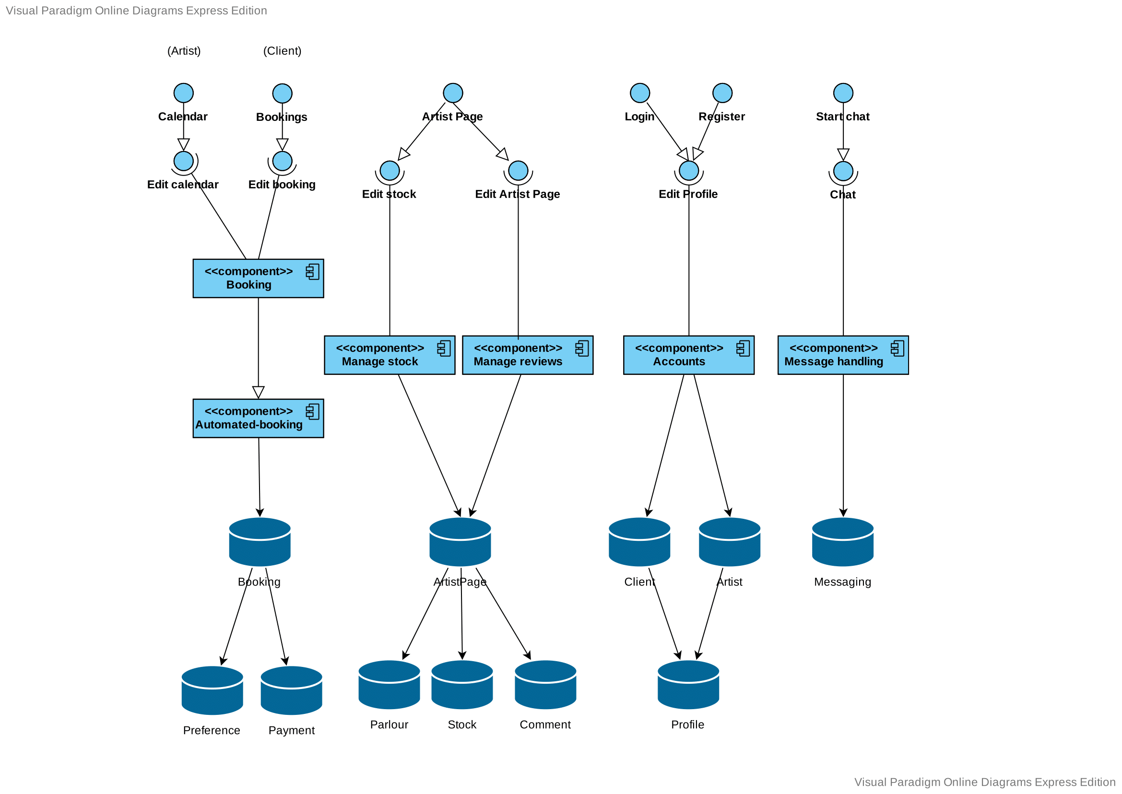
System

Slide 6
Requirements
Functional
Create schedule
Book appointment
Create automated appointments
Non-functional
Performance
Availability
Recoverability
Security

Slide 7
Testing
Unit
Integration
System
Usability
“End-user” (Developer)

Slide 8
Technologies
Website
HTML, CSS, PHP
jQuery, JavaScript
External Database
MySQL, SQLite
External systems
PayPal
Facebook sign in, Google sign in
Messaging system – SendBird

Slide 9
What’s next?
Implement the other Use Cases
Research if necessary
By end of March 2020
Testing
By end of April

Slide 10
Prototype

Slide 11
Feedback
?

